Slide 1
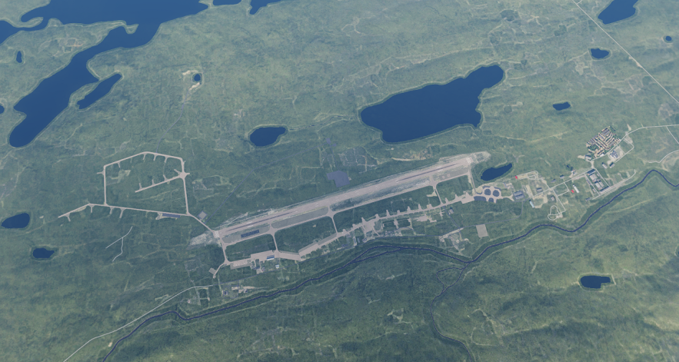
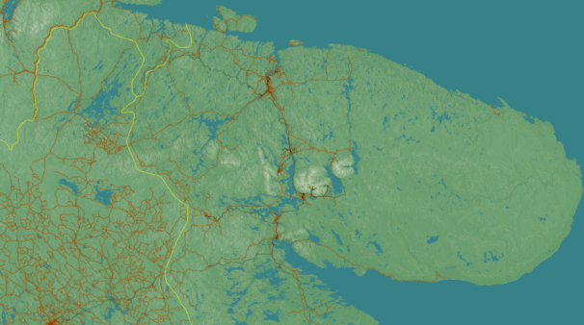
SRNTGT002 SEVOROMORSK-3
N
02
DESCRIPTION OF THE DESIRED POINTS OF IMPACT WITH WPN TYPE:
SRNTGT002-A: N 68 52.015 E 033 43.088/540ft
SRNTGT002-B: N 68 51.908 E 033 43.076/549ft
SRNTGT002-C: N 68 51.610 E 033 43.031/561ft
SRNTGT002-D: N 68 51.404 E 033 43.857/539ft/ 1x 2000lb
SRNTGT002-E: N 68 51.410 E 033 43.766/555ft/ 1x 2000lb
SRNTGT002-F: N 68 51.352 E 033 43.856/555ft/ 1x 2000lb
SRNTGT002-G: N 68 51.339 E 033 43.847/555ft/ 1x 2000lb
SRNTGT002-H: N 68 51.317 E 033 43.790/556ft/ 1x 2000lb
SRNTGT002-I: N 68 51.483 E 033 40.635/621ft/N/A
SRNTGT002-J: N 68 51.454 E 033 40.695/609ft/2x 500lb
SRNTGT002-K: N 68 51.439 E 033 40.629/606ft/2x 500lb
SRNTGT002-L: N 68 51.412 E 033 40.367/632ft/2x 500lb
SRNTGT002-M: N 68 51.446 E 033 40.337/629ft/2x 500lb
SRNTGT002-N: N 68 51.483 E 033 40.346/627ft/2x 500lb

Slide 2
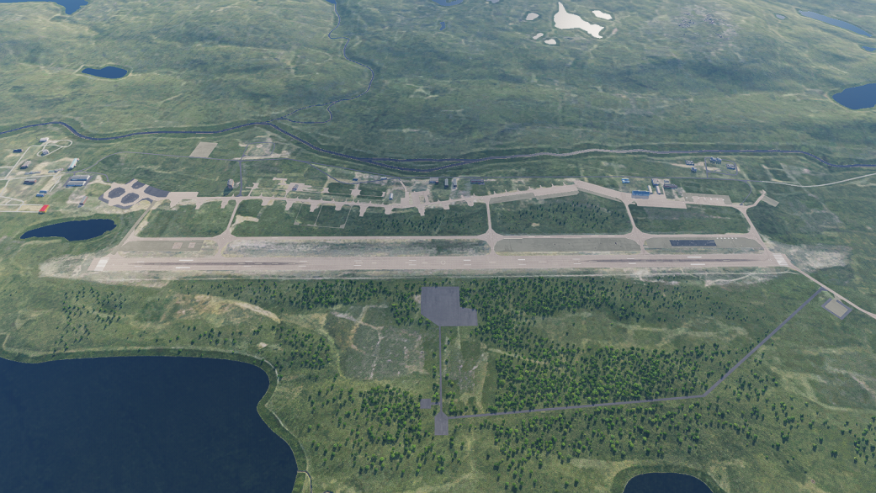
SRNTGT002 RUNWAY DPI A-C
N
DESCRIPTION OF THE DESIRED POINTS OF IMPACT:
DPI A RUNWAY NORTH: N 68 52.015 E 033 43.088/540ft
DPI B RUNWAY CENTER: N 68 51.908 E 033 43.076/549ft
DPI C RUNWAY SOUTH: N 68 51.610 E 033 43.031/561ft
N
A
B
C

Slide 3
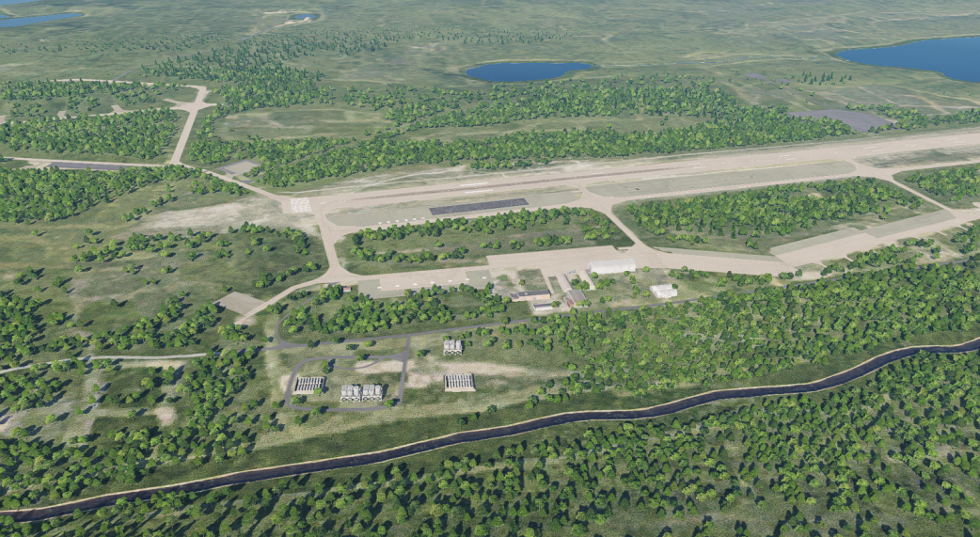
SRNTGT002 FUEL STORAGE DPI D-H
DESCRIPTION OF THE DESIRED POINTS OF IMPACT WITH WPN TYPE:
DPI D: N 68 51.404 E 033 43.857/539ft/ 1x 2000lb
DPI E: N 68 51.410 E 033 43.766/555ft/ 1x 2000lb
DPI F: N 68 51.352 E 033 43.856/555ft/ 1x 2000lb
DPI G: N 68 51.339 E 033 43.847/555ft/ 1x 2000lb
DPI H: N 68 51.317 E 033 43.790/556ft/ 1x 2000lb
N
E
H
F
D
G

Slide 4
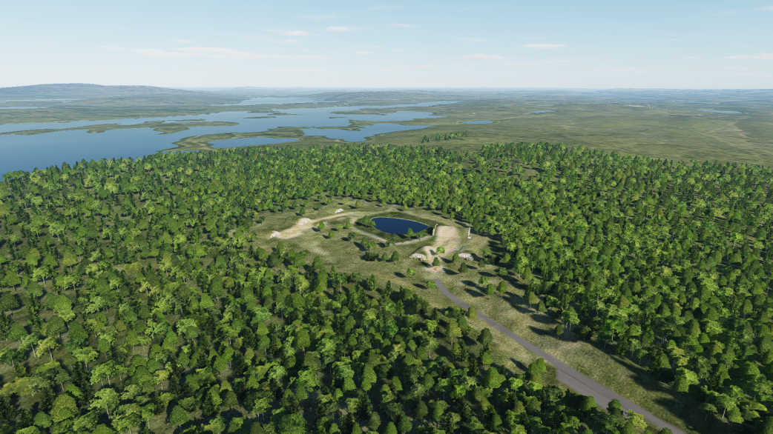
SRNTGT002 AMMO STORAGE DPI I-N
N
DESCRIPTION OF THE DESIRED POINTS OF IMPACT WITH WPN TYPE:
DPI I: N 68 51.483 E 033 40.635/621ft/N/A
DPI J: N 68 51.454 E 033 40.695/609ft/2x 500lb
DPI K: N 68 51.439 E 033 40.629/606ft/2x 500lb
DPI L: N 68 51.412 E 033 40.367/632ft/2x 500lb
DPI M: N 68 51.446 E 033 40.337/629ft/2x 500lb
DPI N: N 68 51.483 E 033 40.346/627ft/2x 500lb
M
N
I
L
J
K

